Slide 1
Chapter 7
Inheritance
李晔锋

Slide 2
Key Skills & Concepts
Understand inheritance basics
Call superclass constructors
Use super to access superclass members
Create a multilevel class hierarchy
Know when constructors are called
Understand superclass references to subclass objects
Override methods
Use overridden methods to achieve dynamic method dispatch

Slide 3
Key Skills & Concepts
Use abstract classes
Use final
Know the Object class

Slide 4
Inheritance Basis
Inheritance is one of the three foundation principles of object-oriented programming because it allows the creation of hierarchical classifications.
In the language of Java, a class that is inherited is called a superclass（父类或超类）. The class that does the inheriting is called a subclass（子类）. Such is done by using the extends keyword. Thus, the subclass adds to (extends) the superclass.

Slide 5
This is the superclass
public class TwoDShape {
double width;
double height;
void showDim() {
System.out.println("width= " + width + " height= " + height);
}
}
This is the subclass
public class Triangle extends TwoDShape {
String style;
double area() {
return width * height / 2;
}
void showStyle() {
System.out.println("Triangle is " + style);
}
}

Slide 6
public class Shapes {
public static void main(String[] args) {
// TODO Auto-generated method stub
Triangle t1 = new Triangle();
Triangle t2 = new Triangle();
t1.width = 4.0;
t1.height = 4.0;
t1.style = "filled";
t2.width = 8.0;
t2.height = 12.0;
t2.style = "outlined";
System.out.println("Info for t1: ");
t1.showStyle();
t1.showDim();
System.out.println("Area is " + t1.area());
System.out.println();
System.out.println("Info for t2: ");
t2.showStyle();
t2.showDim();
System.out.println("Area is " + t2.area());
}
}

Slide 7
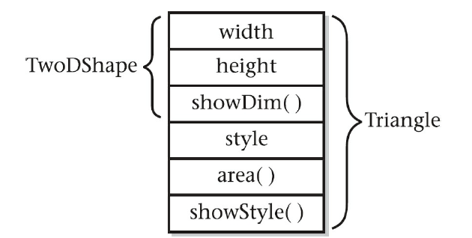
Inheritance Basis
Subclass can include, in other words, inherit all non-private members from its superclass.
For example, the Triangle class has inherited width, height, and showDim() from the TwoDShape class.

Slide 8
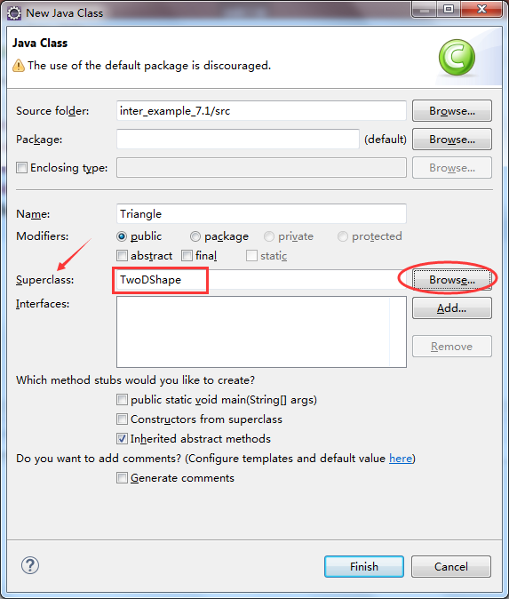
Create a subclass in Eclipse
Suppose you have the superclass, namely, TwoDShape.
Now, in the “New class” dialog, fill in the class name “Triangle” first, and then fill in the “superclass” blank with the superclass name, TwoDShape. You can click the “Browse” button as an assistant.
Finally, click “Finish”.

Slide 9
Advantage of Inheritance
A major advantage of inheritance is that once you have created a superclass that defines the attributes common to a set of objects, it can be used to create any number of more specific subclasses. Each subclass can precisely tailor its own classification.
public class Rectangle extends TwoDShape {
boolean isSquare() {
if(width == height) return true;
else return false;
}
double area() {
return width * height;
}
}

Slide 10
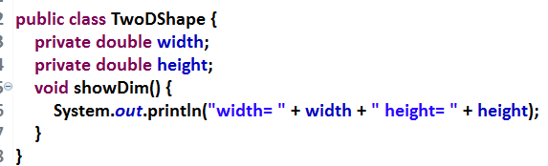
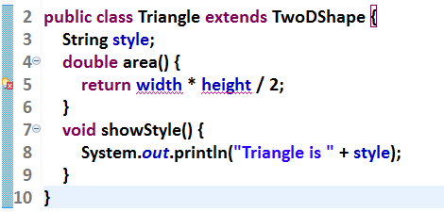
Member Access and Inheritance
If a member of superclass is declared private, it could not be inherited.

Slide 11
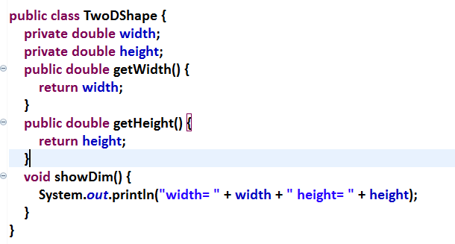
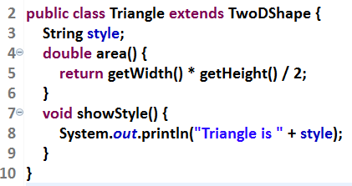
Use the Entity Class

Slide 12
Constructors and Inheritance
If both superclass and subclass have parameterized constructors, the constructor for the superclass constructs the superclass portion of the object, and the constructor for the subclass constructs the subclass part.
If only the subclass has constructors, the superclass portion of the object is constructed automatically using its default constructor.

Slide 13
public class TwoDShape {
private double width;
private double height;
public double getWidth() {return width;}
public double getHeight() {return height;}
public void setWidth(double w) {width = w;}
public void setHeight(double h) {height = h;}
void showDim() {
System.out.println("width= " + width + " height= " + height);
}
}
public class Triangle extends TwoDShape {
private String style;
Triangle(String s, double w, double h){
setWidth(w);
setHeight(h);
style = s;
}
double area() {
return getWidth() * getHeight() / 2;
}
void showStyle() {
System.out.println("Triangle is " + style);
}
}

Slide 14
public class Shape3 {
public static void main(String[] args) {
// TODO Auto-generated method stub
Triangle t1 = new Triangle("filled",4.0,4.0);
Triangle t2 = new Triangle("outlined",8.0,12.0);
System.out.println("Info for t1: ");
t1.showStyle();
t1.showDim();
System.out.println("Area is " + t1.area());
System.out.println();
System.out.println("Info for t2: ");
t2.showStyle();
t2.showDim();
System.out.println("Area is " + t2.area());
}
}

Slide 15
The Hidden Member
If a member variable in the subclass has the same name as that in the superclass, the latter will be hidden by the former.
public class A {
public int member = 1;
public int getMember(){
return member;
}
}
public class Main {
public static void main(String[] args){
A a = new A();
B b = new B();
a.member = 10;
b.member = 10.1;
System.out.println(a.getMember());
System.out.println(b.getMember());
}
}
public class B extends A {
public double member = 1.5;
}
The value of the hidden variable can be retrieved by corresponding methods..

Slide 16
Method Overriding（重写）
In a class hierarchy, when a method in a subclass has the same return type and signature as a method in its superclass, then the method in the subclass is said to override the method in the superclass.
When an overridden method is called from within a subclass, it will always refer to the version of that method defined by the subclass. The version of the method defined by the superclass will be hidden.

Slide 17
Method Overriding
public class Main {
public static void main(String[] args) {
A a = new A();
B b = new B();
a.member = 10;
b.member = 10;
System.out.println(a.getMember());
System.out.println(b.getMember());
}
}
public class A {
public int member = 1;
public int getMember() {
return member;
}
}
public class B extends A {
public int getMember(){
return member*2;
}
}

Slide 18
Attention of Overriding
You should not lower the method access level .
class A {
protected float f(float x,float y) {
return x-y;
}
}
class B extends A {
float f(float x,float y) {//Error, level down!
return x+y ;
}
}
class C extends A {
public float f(float x,float y) {//OK! Level up!
return x*y ;
}
}

Slide 19
Attention of Overriding
You should not override static to non-static.
class A {
public static float f(float x,float y) {
return x-y;
}
}
class B extends A {
public float f(float x,float y) {//error
return x+y ;
}
}
class C extends A {
public static float f(float x,float y) {//OK
return x*y ;
}
}

Slide 20
The super Keyword
The super keyword is used to access the hidden member variable or method. The general form of super is:
super.variable
super.method()
Note: If the hidden method is declared to be static, it could not be accessed by super.

Slide 21
Operating the Hidden Variables Using super
public class A {
public int x = 1;
}
public class B extends A{
public int x = 2;
public void print(int x){
System.out.println(x);
System.out.println(this.x);
System.out.println(super.x);
}
public static void main(String[] args){
B b = new B();
b.print(3);
}
}

Slide 22
Operating the Hidden Methods Using super
public class A {
public int compute1(int a, int b){
return a+b;
}
public static int compute2(int a, int b){
return a+b;
}
}
public class B extends A {
public int compute1(int a, int b){
int c = super.compute1(a, b);
return c*c;
}
public static int compute2(int a, int b){
int c = super.compute2(a,b); //Error!
return c*c;
}
}

Slide 23
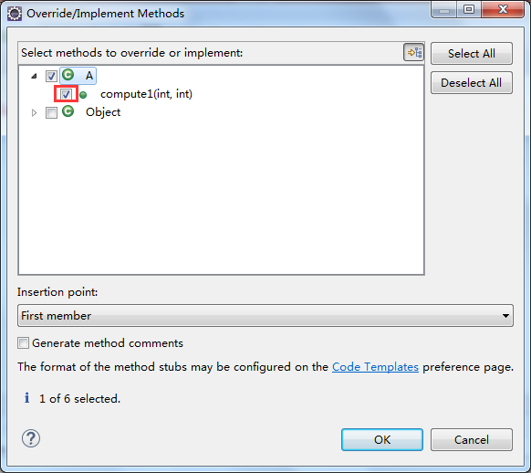
Overriding a Method Using Eclipse
Create a subclass of A, named as C from the previous example. Switch to C, click “source” → “Implement/Override Methods”. Then select the methods you want to override.

Slide 24
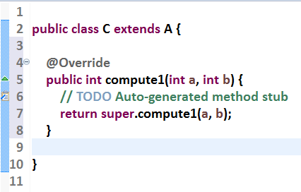
An overridden method will be generated. You can make changes to it as you wish.

Slide 25
Using super to Call Superclass Constructors
The keyword super can also be used to call the constructors of the superclass.
public class TwoDShape {
private double width;
private double height;
TwoDShape(double w,double h){
width = w; height = h;
}
public double getWidth() {return width;}
public double getHeight() {return height;}
public void setWidth(double w) {width = w;}
public void setHeight(double h) {height = h;}
void showDim() {
System.out.println("width= " + width +
" height= " + height);
}
}
public class Triangle extends TwoDShape {
private String style;
Triangle(String s, double w, double h){
super(w,h);
style = s;
}
double area() {
return getWidth() * getHeight() / 2;
}
void showStyle() {
System.out.println("Triangle is " + style);
}
}

Slide 26
public class Shape4 {
public static void main(String[] args) {
// TODO Auto-generated method stub
Triangle t1 = new Triangle("filled",4.0,4.0);
Triangle t2 = new Triangle("outlined",8.0,12.0);
System.out.println("Info for t1: ");
t1.showStyle();
t1.showDim();
System.out.println("Area is " + t1.area());
System.out.println();
System.out.println("Info for t2: ");
t2.showStyle();
t2.showDim();
System.out.println("Area is " + t2.area());
}
}

Slide 27
Calling super with Default Constructor
public class Triangle extends TwoDShape {
private String style;
Triangle(){
super();
style = "none";
}
Triangle(String s, double w, double h){
super(w,h);
style = s;
}
Triangle(double x){
super(x);
style = "filled";
}
double area() {
return getWidth() * getHeight() / 2;
}
void showStyle() {
System.out.println("Triangle is " + style);
}
}
public class TwoDShape {
private double width;
private double height;
TwoDShape(){
width = height = 0;
}
TwoDShape(double w,double h){
width = w; height = h;
}
TwoDShape(double x){
width = height = x;
}
public double getWidth() {return width;}
public double getHeight() {return height;}
public void setWidth(double w) {width = w;}
public void setHeight(double h) {height = h;}
void showDim() {
System.out.println("width= " + width +
" height= " + height);
}
}

Slide 28
public class Shape5 {
public static void main(String[] args) {
// TODO Auto-generated method stub
Triangle t1 = new Triangle();
Triangle t2 = new Triangle("outlined",8.0,12.0);
Triangle t3 = new Triangle(4.0);
System.out.println("Info for t1: ");
t1.showStyle();
t1.showDim();
System.out.println("Area is " + t1.area());
System.out.println();
System.out.println("Info for t2: ");
t2.showStyle();
t2.showDim();
System.out.println("Area is " + t2.area());
System.out.println();
System.out.println("Info for t3: ");
t3.showStyle();
t3.showDim();
System.out.println("Area is " + t3.area());
}
}

Slide 29
Creating a Multilevel Hierarchy
We can build hierarchies that contain as many layers of inheritance as you like. As mentioned, it is perfectly acceptable to use a subclass as a superclass of another.
For example, given three classes called A, B, and C, C can be a subclass of B, which is a subclass of A. When this type of situation occurs, each subclass inherits all of the traits found in all of its superclasses. In this case, C inherits all aspects of B and A.
A
B
C

Slide 30
Creating a Multilevel Hierarchy
To see how a multilevel hierarchy can be useful, consider the following program. In it, the subclass Triangle is used as a superclass to create the subclass called ColorTriangle. ColorTriangle inherits all of the traits of Triangle and TwoDShape and adds a field called color, which holds the color of the triangle.
TwoDShape
Triangle
ColorTriangle

Slide 31
public class Triangle extends TwoDShape {
private String style;
Triangle(){
super();
style = "none";
}
Triangle(String s, double w, double h){
super(w,h);
style = s;
}
Triangle(double x){
super(x);
style = "filled";
}
double area() {
return getWidth() * getHeight() / 2;
}
void showStyle() {
System.out.println("Triangle is " + style);
}
}
public class TwoDShape {
private double width;
private double height;
TwoDShape(){
width = height = 0;
}
TwoDShape(double w,double h){
width = w; height = h;
}
TwoDShape(double x){
width = height = x;
}
public double getWidth() {return width;}
public double getHeight() {return height;}
public void setWidth(double w) {width = w;}
public void setHeight(double h) {height = h;}
void showDim() {
System.out.println("width= " + width +
" height= " + height);
}
}

Slide 32
public class ColorTriangle extends Triangle {
private String color;
ColorTriangle(String c,String s,double w,double h){
super(s,w,h);
color = c;
}
public String getColor() {return color;}
public void showColor() {
System.out.println("Color is "+ color);
}
}

Slide 33
Creating a Multilevel Hierarchy
Because of inheritance, ColorTriangle can make use of the previously defined classes of Triangle and TwoDShape, adding only the extra information it needs for its own, specific application.
This example illustrates one other important point: super( ) always refers to the constructor in the closest superclass. The super( ) in ColorTriangle calls the constructor in Triangle. The super( ) in Triangle calls the constructor in TwoDShape.

Slide 34

When Are Constructors Executed?
public class A {
A() {
System.out.println("Constructing A.");
}
}
public class OrderOfConstruction {
public static void main(String[] args) {
// TODO Auto-generated method stub
C c = new C();
}
}
public class B extends A {
B(){
System.out.println("Constructing B.");
}
}
public class C extends B {
C(){
System.out.println("Constructing C.");
}
}

Slide 35
Superclass References and Subclass Objects
A reference variable of a superclass can be assigned a reference to an object of any subclass derived from that superclass. In other words, a superclass reference can refer to a subclass object.
For example, if A is the superclass, B is the subclass, you can write as follows:
A a = new B();
Or
A a;
B b = new B();
a = b;

Slide 36
public class X {
int a;
X(int i){a = i;}
}
public class SupSubRef {
public static void main(String[] args) {
// TODO Auto-generated method stub
X x = new X(10);
X x2;
Y y = new Y(5,6);
x2 = x;
System.out.println("x2.a: " + x2.a);
x2 = y;
System.out.println("x2.a" + x2.a);
x2.a = 19;
//x2.b = 27; //Error!
}
}
public class Y extends X {
int b;
Y(int i, int j){
super(j);
b = i;
}
}

Slide 37
Superclass References and Subclass Objects
A superclass reference of its subclass is able to access the inherited or hidden variables and methods, but not the newly added ones.
newly added variables
superclass reference
newly added methods
subclass object
inherited or hidden variables
inherited or overridden methods

Slide 38
public class A {
public int compute1(int a,int b){
return a+b;
}
}
public class B extends A {
public int compute1(int a,int b){
int c=super.compute1(a, b);
return c*c;
}
public int compute2(int a,int b){
return a-b;
}
}

Slide 39
public class Main {
public static void main(String[] args){
A a1=new A(); //Object created by superclass
A a2=new B(); //Subclass reference
//Output 5
System.out.println(a1.compute1(2, 3));
//Output 25
//System.out.println(a2.compute1(2, 3));
//Error, the subclass reference cannot call newly
//added methods
System.out.println(a2.compute2(2, 3));
//Cast to subclass object
System.out.println(((B)a2).compute2(2, 3));
//Error, cannot make subclass reference
// B b = new A();
}
}

Slide 40
Superclass References and Subclass Objects
Don’t be confused with superclass objects and superclass references.
Don’t make subclass references to superclass.
You can cast the superclass reference to subclass objects to access the newly added variables and methods.

Slide 41
Polymorphism（多态）
As we know, a superclass reference variable can refer to a subclass object, and call the overridden methods.
When different types of objects are referred to, different versions of an overridden method will be called. We call such case polymorphism.
Animal
cry()
Cat
Dog
Mouse
cry()
cry()
cry()

Slide 42

Polymorphism
public class Animal {
void cry() {}
}
public class MainClass {
public static void main(String[] args) {
// TODO Auto-generated method stub
Animal an = new Cat();
an.cry();
an = new Dog();
an.cry();
an = new Mouse();
an.cry();
}
}
public class Cat extends Animal {
void cry() {
System.out.println("喵喵");
}
}
public class Dog extends Animal {
void cry() {
System.out.println("汪汪");
}
}
public class Mouse extends Animal {
void cry() {
System.out.println("吱吱");
}
}

Slide 43
Why Overridden Methods?
Overridden methods allow Java to support run-time polymorphism.

Slide 44
Applying Method Overriding to TwoDShape
To better understand the power of method overriding, we will apply it to the TwoDShape class.

Slide 45
Using Abstract Classes
Sometimes you will want to create a superclass that defines only a generalized form that will be shared by all of its subclasses, leaving it to each subclass to fill in the details.
You can do it by define an abstract class by adding abstract declaration in front of a class name.

Slide 46
The Abstract Method
Inside the abstract class, you can define abstract methods, by adding the abstract declaration in front of a method name. For example:
abstract int min(int x, int y);
Note:
The abstract class may have abstract methods and non-abstract methods.
The abstract class cannot be initialized using the new keyword.
Subclasses must override the abstract methods.

Slide 47
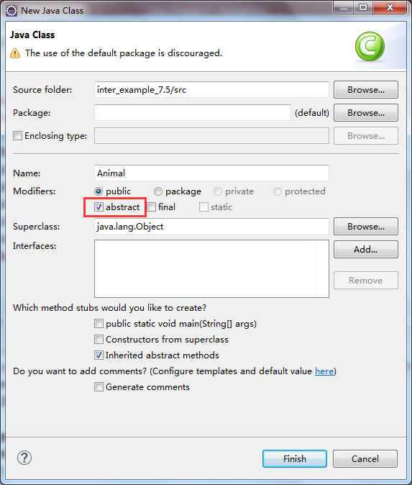
Create an Abstract Class in Eclipse

Slide 48
public abstract class Animal {
abstract void cry();
}
public class MainClass {
public static void main(String[] args) {
// TODO Auto-generated method stub
Animal an = new Cat();
an.cry();
an = new Dog();
an.cry();
an = new Mouse();
an.cry();
}
}
public class Cat extends Animal {
void cry() {
System.out.println("喵喵");
}
}
public class Dog extends Animal {
void cry() {
System.out.println("汪汪");
}
}
public class Mouse extends Animal {
void cry() {
System.out.println("吱吱");
}
}

Slide 49
The Abstract Version of TwoDShape
public abstract class TwoDShape {
private double width;
private double height;
private String name;
TwoDShape(){
width = height = 0;
name = "none";
}
TwoDShape(double w,double h, String n){
width = w; height = h;
name = n;
}
TwoDShape(double x,String n){
width = height = x;
name = n;
}
TwoDShape(TwoDShape ob){
width = ob.width;
height = ob.height;
name = ob.name;
}
public double getWidth() {return width;}
public double getHeight() {return height;}
public void setWidth(double w) {width = w;}
public void setHeight(double h) {height = h;}
public String getName() {return name;}
void showDim() {
System.out.println("width= " + width +
" height= " + height);
}
abstract double area() ;
}

Slide 50
public class Triangle extends TwoDShape {
private String style;
Triangle(){
super();
style = "none";
}
Triangle(String s, double w, double h){
super(w,h,"triangle");
style = s;
}
Triangle(double x){
super(x,"triangle");
style = "filled";
}
Triangle(Triangle ob){
super(ob);
style = ob.style;
}
double area() {
return getWidth() * getHeight() / 2;
}
void showStyle() {
System.out.println("Triangle is " + style);
}
}
public class Rectangle extends TwoDShape {
Rectangle(){
super();
}
Rectangle(double w, double h){
super(w,h,"rectangle");
}
Rectangle(double x){
super(x,"rectangle");
}
Rectangle(Rectangle ob){
super(ob);
}
boolean isSquare() {
if(getWidth() == getHeight()) return true;
else return false;
}
double area() {
return getWidth()*getHeight();
}
}

Slide 51
public class DynShapes {
public static void main(String[] args) {
// TODO Auto-generated method stub
TwoDShape shapes[] = new TwoDShape[4];
shapes[0] = new Triangle("outlined",8.0,12.0);
shapes[1] = new Rectangle(10);
shapes[2] = new Rectangle(10,4);
shapes[3] = new Triangle(7.0);
for(int i=0; i < shapes.length; i++) {
System.out.println("Object is " + shapes[i].getName());
System.out.println("Area is " + shapes[i].area());
System.out.println();
}
}
}

Slide 52
Using final
Sometimes, if you want to prevent something being inherited or overridden, you can use the keyword final.
If you add final in front of a method, it could not be overridden.
If you add final in front of a class, it could not be inherited.

Slide 53
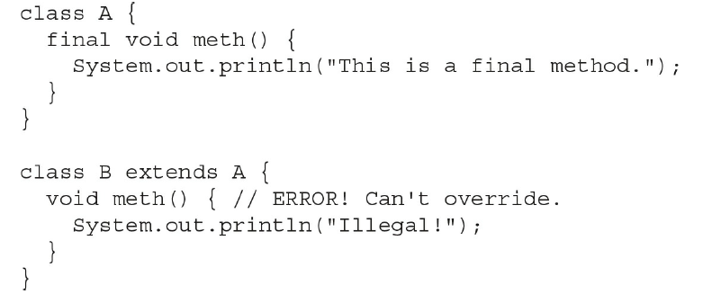
final Prevents Overriding

Slide 54
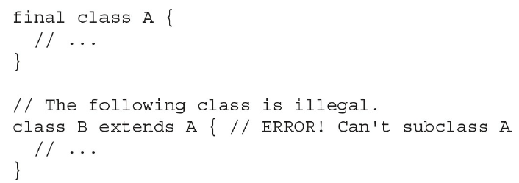
final Prevents Inheritance

Slide 55
Using final with Data Members
The keyword final can also be applied to member variables to create what amounts to named constants. If you precede a class variable’s name with final, its value cannot be changed throughout the lifetime of your program.

Slide 56
Using final with Data Members
public class Circle {
private double radius;
final double PI = 3.1415926;
Circle(double r){
radius = r;
}
double area(){
return PI * radius * radius;
}
}

Slide 57
public class ErrorMsg {
String msgs[] = {"Output Error", "Input Error",
"Disk Full","Index Out-Of-Bounds"};
String getErrorMsg(int i) {
if(i >= 0 && i < msgs.length)
return msgs[i];
else
return "Invalid Error Code";
}
}
public class FinalD {
final static int OUTERR = 0;
final static int INERR = 1;
final static int DISKERR = 2;
final static int INDEXERR = 3;
public static void main(String[] args) {
// TODO Auto-generated method stub
ErrorMsg err = new ErrorMsg();
System.out.println(err.getErrorMsg(OUTERR));
System.out.println(err.getErrorMsg(INDEXERR));
}
}

Slide 58
The Object Class
Java defines one special class called Object that is an implicit superclass of all other classes. In other words, all other classes are subclasses of Object. This means that a reference variable of type Object can refer to an object of any other class. Also, since arrays are implemented as classes, a variable of type Object can also refer to any array.

Slide 59
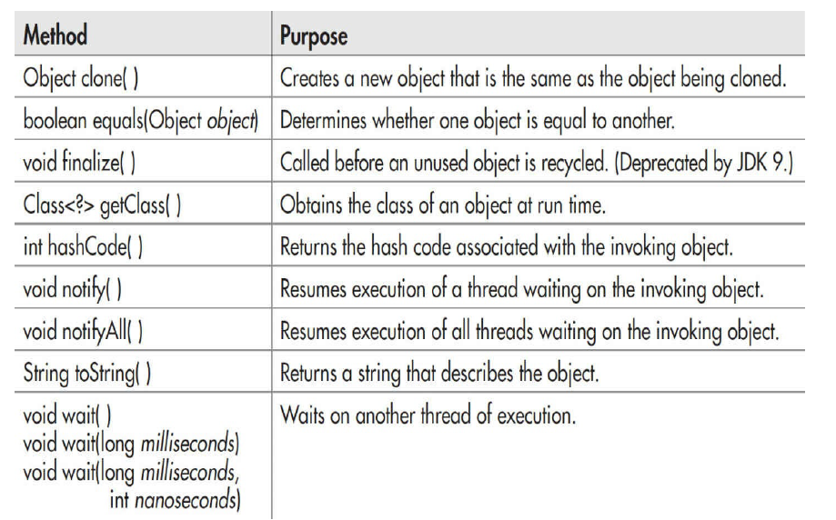
Methods of The Object Class

Slide 60
Abstract Oriented Programming---- A Case Study
Suppose you are asked to create a pillar（柱体）, with its bottom a triangle. We know that the volume of the pillar should be: area of bottom * height. The Pillar class is created as follows:
public class Pillar {
Triangle bottom;
double height;
Pillar(Triangle bottom,double height){
this.bottom = bottom;
this.height = height;
}
double volume() {
return bottom.area() * height;
}
}

Slide 61
Abstract Oriented Programming---- A Case Study
Now, you receive a new task: create a cuboid, where the bottom is a rectangle. What shall you do?
Modify the bottom member to Rectangle, and modify the constructor?
Or, write another Cuboid class, with most of the code redundant?
The answer is “No”. Abstract classes can help you with this problem.

Slide 62
Abstract Oriented Programming---- A Case Study
Let’s use the abstract version of the TwoDShape class.
Modify the data type of bottom variable to TwoDShape.
public class Pillar {
TwoDShape bottom;
double height;
public Pillar(TwoDShape bottom, double height) {
this.bottom = bottom;
this.height = height;
}
double volume() {
return bottom.area() * height;
}
}

Slide 63
Abstract Oriented Programming---- A Case Study
Now another new demand comes: to create a pillar with the bottom of ellipse（椭圆）. We just create the class as follows without modifying the Pillar class.

Slide 64
public class Ellipse extends TwoDShape {
private static final double PI = 3.1415926;
Ellipse(){
super();
}
Ellipse(double w,double h){
super(w,h,"ellipse");
}
Ellipse(double x){
super(x,"ellipse");
}
Ellipse(Ellipse ob){
super(ob);
}
double area() {
return PI * getWidth() * getHeight();
}
}

Slide 65

Abstract Oriented Programming---- A Case Study
public class MainClass {
public static void main(String[] args) {
Pillar p1 = new Pillar(new Triangle("filled",4.0,8.0), 3.0);
Pillar p2 = new Pillar(new Rectangle(5.0,6.0),4.0);
Pillar p3 = new Pillar(new Ellipse(5.0,5.0),8.0);
System.out.println("Volume of p1: " +p1.volume());
System.out.println("Volume of p2: " +p2.volume());
System.out.println("Volume of p3: " +p3.volume());
}
}

Slide 66
Abstract Oriented Programming---- Another Example
Suppose we have a Simulator class, with the usage of playing sound of different animals.
The abstract class Animal is from the previous example.
public class Simulator {
public void play(Animal ob) {
ob.cry();
}
}

Slide 67
Abstract Oriented Programming---- Another Example
The main class defines objects of different animals.
public class MainClass {
public static void main(String[] args) {
// TODO Auto-generated method stub
Simulator sim = new Simulator();
Cat c = new Cat();
Dog d = new Dog();
Mouse m = new Mouse();
sim.play(c);
sim.play(d);
sim.play(m);
}
}

